Slide 1
LINEAR AND LOGISTIC REGRESSION
-BY AMAN SAINI

Slide 2
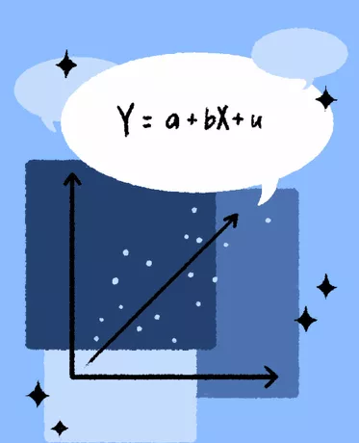
Introduction
A Regression is a statistical method is used determine the strength and character of the relationship between one dependent variable (usually denoted by Y) and a series of other variables (known as independent variables).

Slide 3
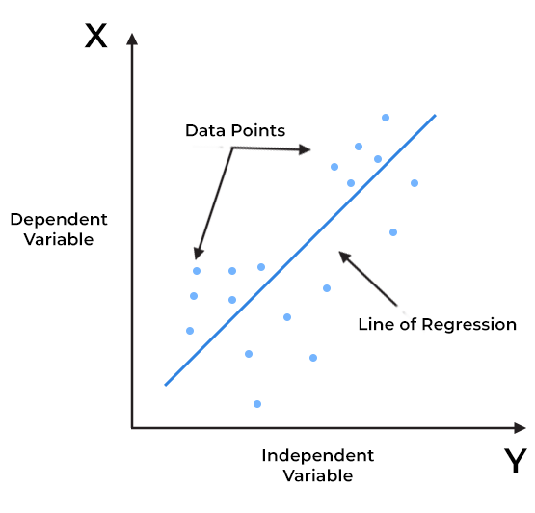
LINEAR REGRESSION
Linear regression is an algorithm that provides a linear relationship between an independent variable and a dependent variable to predict the outcome of future events.

Slide 4
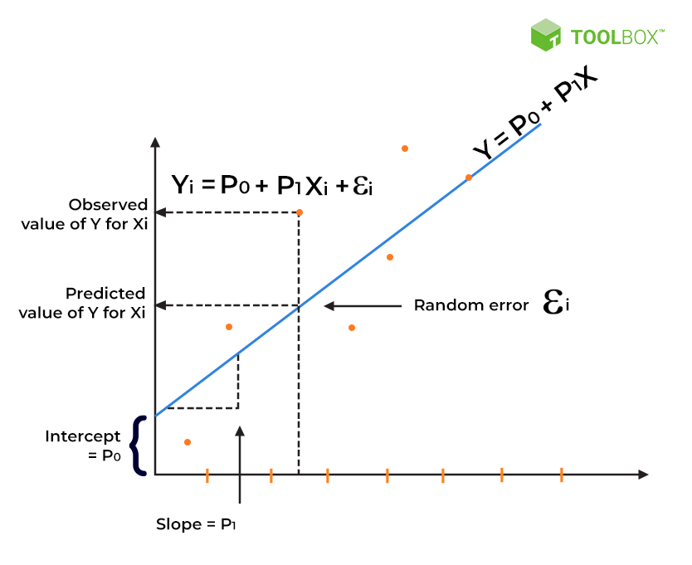
VISUALISATION OF EQUATION FOR LINEAR REGRESSION
Yi = P0 + P1Xi
where, Yi = Dependent variable,
P0 = constant/Intercept,
P1 = Slope/Intercept,
Xi = Independent variable.

Slide 5
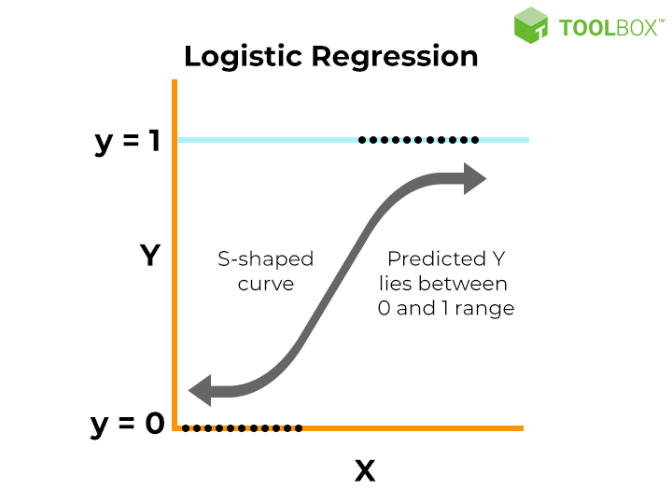
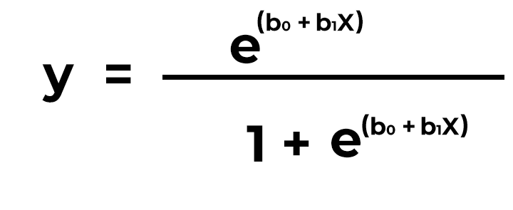
LOGISTIC REGRESSION
Logistic regression is used to describe data and the relationship between one dependent variable and one or more independent variables. The independent variables can be nominal, ordinal, or of interval type.The dependent variable is
binary type.

Slide 6
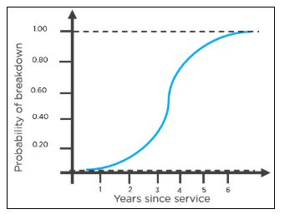
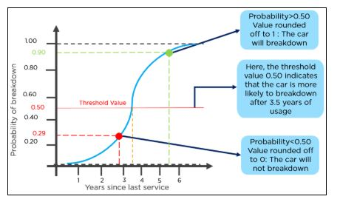
LOGISTIC REGRESSION

Slide 7

RESEARCH PAPER FOR HEART ATTACK PREDICTION USING LOGISTIC REGRESSION
Heart Attack Analysis and Prediction using Logistic Regression
By A. S. Thanuja Nishadi.
Published in 2020.
ABTRACT :
. The aim of this study is to identify the most significant predicator of heart diseases and predicting the overall risks by using logistic regression. Thus, binary logistic model which is one of the classification algorithms in machine learning is used in this study to identify the predicator.

Slide 8
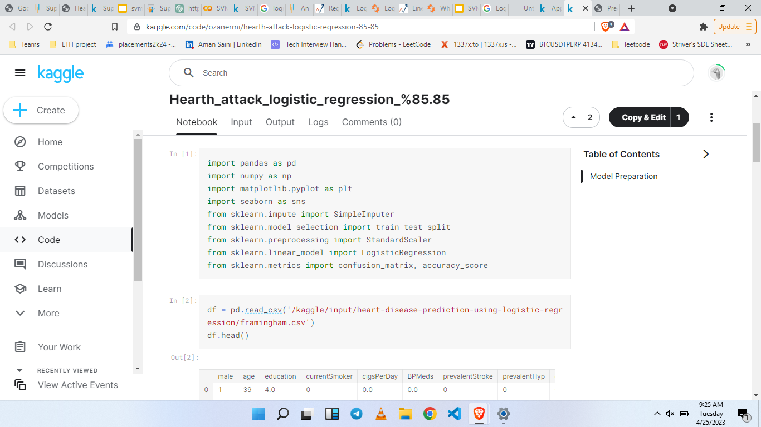
CODE FOR HEART ATTACK PREDICTION
Problem Description :
Predict the Heart Disease based on given attributes
Dataset :
The dataset which used for the logistic regression analysis is available on the Kaggle.

Slide 9
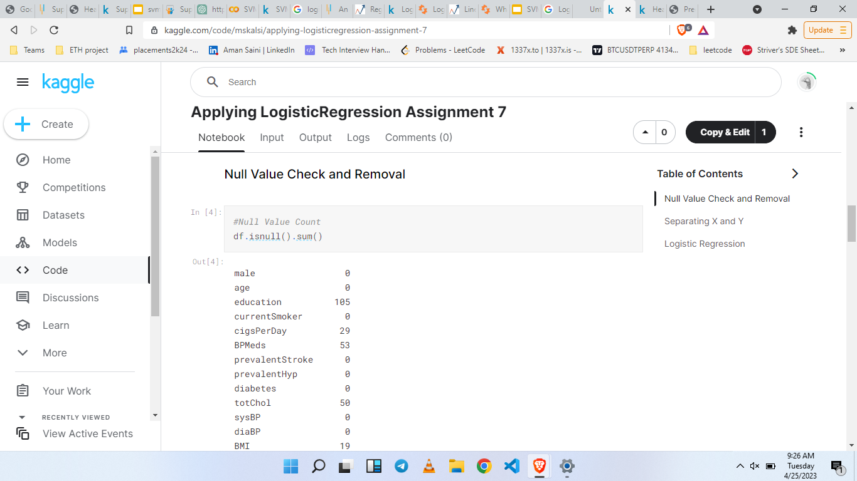
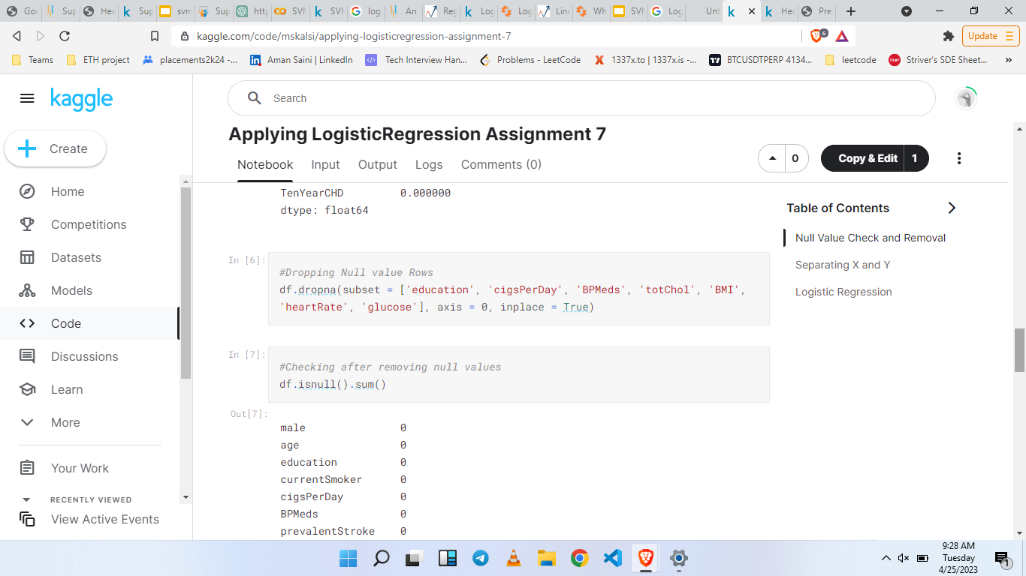
CODE FOR HEART ATTACK PREDICTION - 2

Slide 10
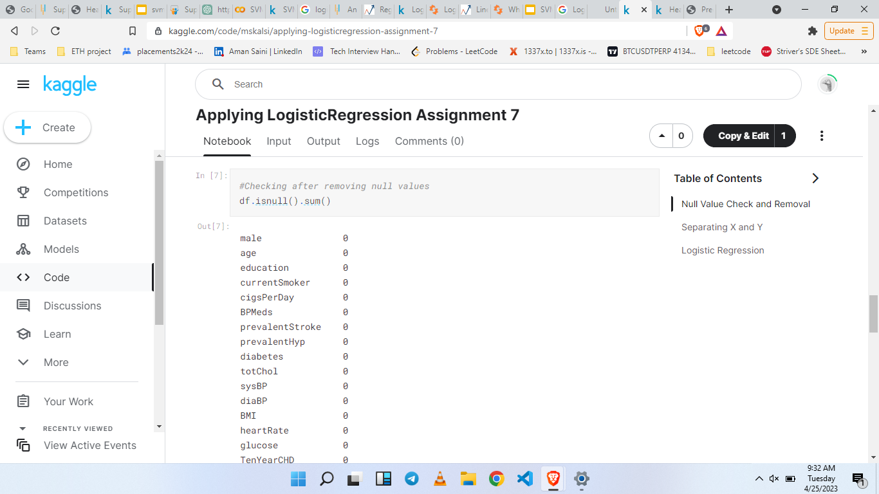
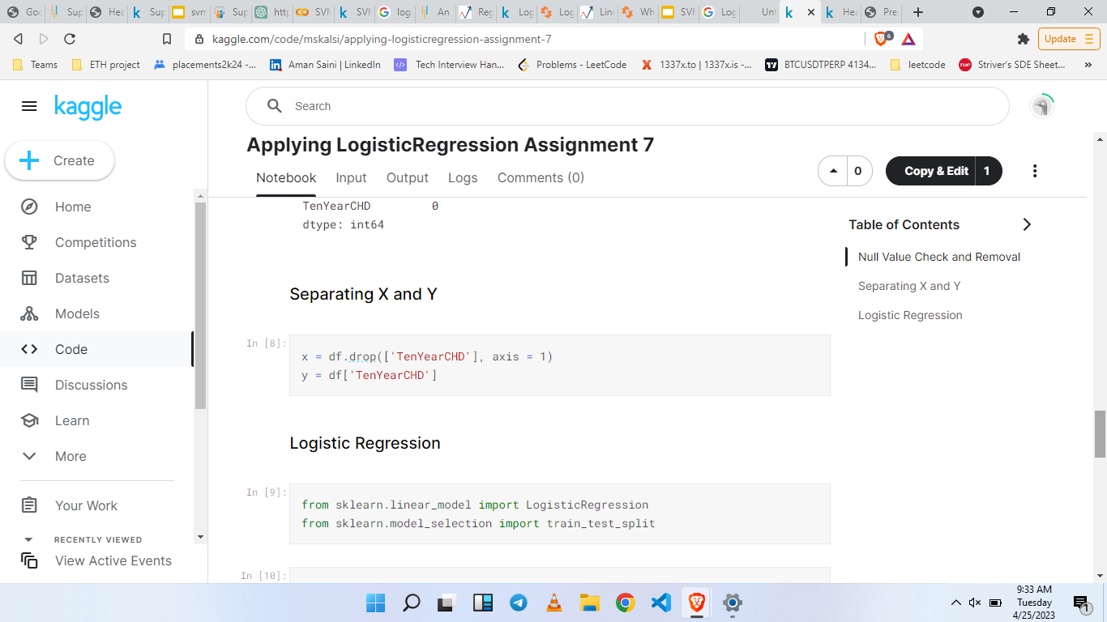
CODE FOR HEART ATTACK PREDICTION - 3

Slide 11
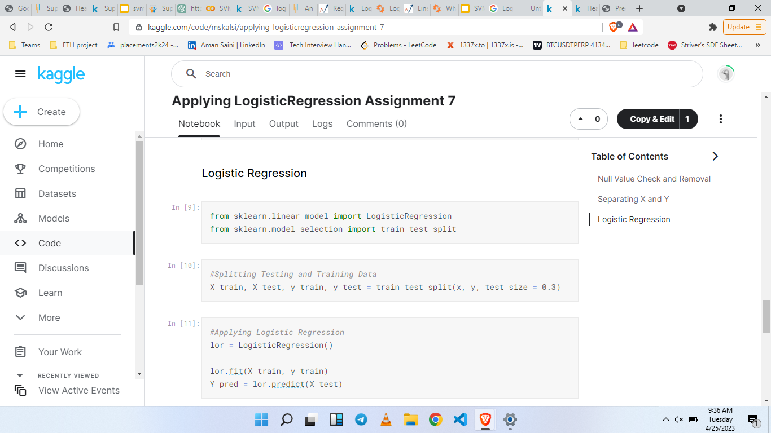
CODE FOR HEART ATTACK PREDICTION - 4

Slide 12
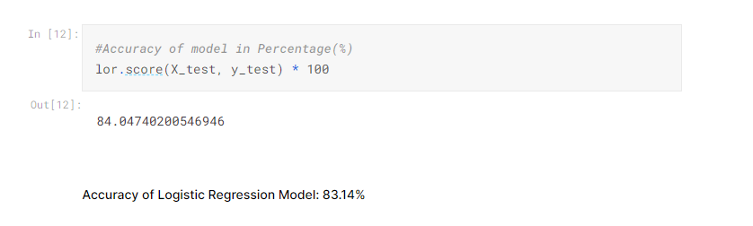
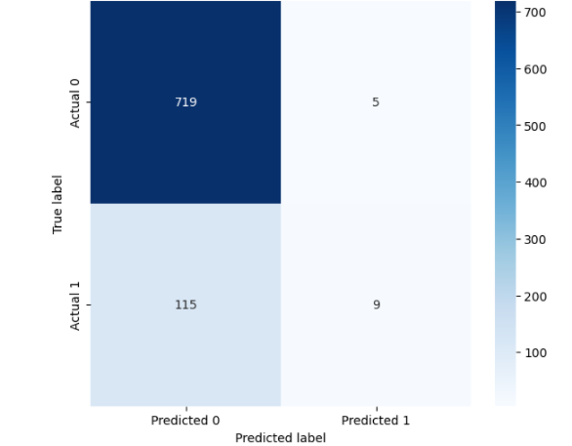
CODE FOR HEART ATTACK PREDICTION - 5

Slide 13
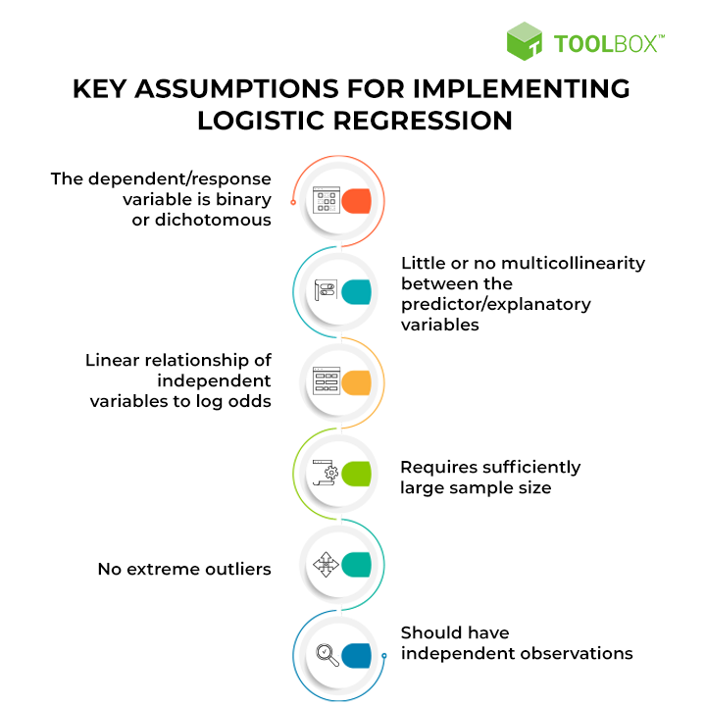
KEY ASSUMPTIONS FOR LOGISTIC REGRESSION

Slide 14
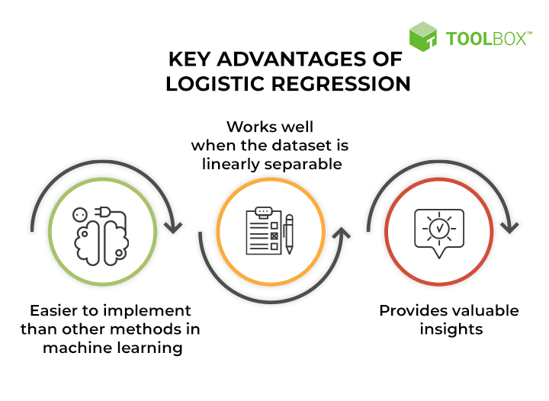
ADVANTAGES OF LOGISTIC REGRESSION

Slide 15
THANK YOU
-BY AMAN SAINI

